Slide 1
AIPM Assignment 1
Akshaya patra/Cornpcopia Endless safe food discovery. Transforming food anxiety into culinary abundance

Slide 2
Walmart is the world’s largest corporate retail establishment and second-largest company by global revenue. Walmart’s revenue as of mid 2026 is 725.31 billon. Walmart sells everything ☺
Walmart is extremely well run company and does many things well for but for the purpose of this exercise lets talk about the Evolution of Walmarts’s AI and Data Science.
Walmart opened in 1969.
The Shift to Cloud: Early 2010s
Early AI & Recommendation Engines: Walmart deployed its advanced, modern AI Content Decision Platform for hyper-personalized shopping recommendations on October 9, 2024.
Sparky (AI Assistant): Walmart officially launched its agentic conversational shopping companion, Sparky, on June 6, 2025.
OpenAI Partnership: Walmart announced an AI-first commerce integration with OpenAI on October 14, 2025.
Where do things go wrong, or get slow, expensive, or frustrating?
Food is major recurring expense and Walmart's recommendation system sucks, for that matter so does every recommendation engine I have tried at least when it comes to food recommendations.
I personally suffer with food allergies and I get really frustrated about their food recommendations, so far I have never gotten a good recommendation.
Please note U.S. total grocery universe has roughly 500,000 to 1,000,000+ distinct grocery SKUs/variants and Walmart’s daily assortment is roughly 20,000 to 50,000 grocery items in a typical store-level view, and 100,000+ when you include broader online + regional assortment exposure so finding a product that is safe for someone with allergies to eat should be doable.
Per this article, Walmart uses “Item Cross-Pollination (XP) recommendation framework “, where food products are just another product but I do not agree with this categorization.
What information or data does the business collect along the way?
Per this Linkedin article , Walmart collects 2.5 petabytes of unstructured data from 1 million customers every hour.

Slide 3
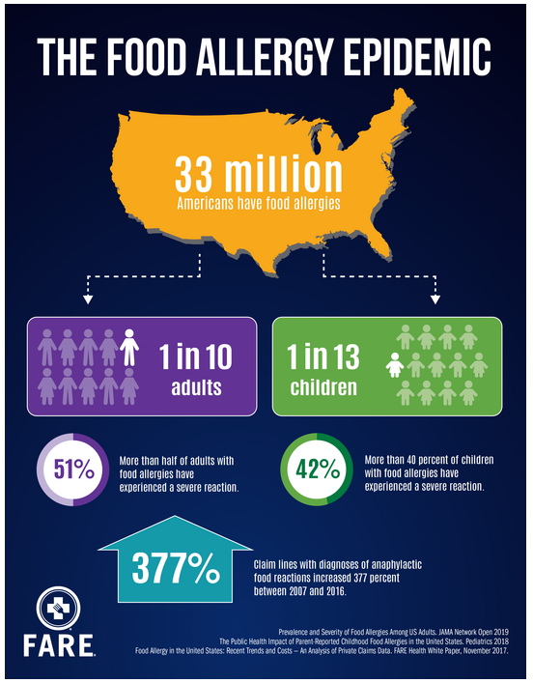
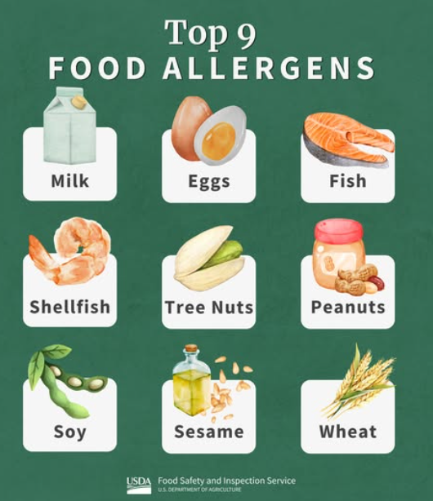
The Food Allergy Epidemic
Derivatives of Milk
Milk | Lactalbumin
Yogurt | Lactoglobulin
Butter | Ghee
Curd | Cream
Casein | Cheese
Caseinate | Milk solids
Whey | Nonfat milk solids
Lactose | Whey powder
US loses over 25B dollars every year due to food allergies
According to consumer insights by Food Allergy Research & Education (FARE), the buying power of food-allergic consumers represents a $19 billion market opportunity.

Slide 4
Feature | Problem it solves | Type of AI | Data needed | What it improves | Metrics it will impact
Customer allergy risk prediction: Predict the probability that a customer is sensitive or allergic to each of the top 9 allergens based on purchase behavior and ingredient patterns. | Tells us what a certain customer’s buying pattern is when it comes to foods with allergens | Prediction AI -Multi model classification | Several months of a users purchases , the users preferences(optional) and USDA or stores product DB with ingredients, labels, nutrition information | Shows a customers sensitivity to top 9 allergens. | Exact Match Ratio, Hamming Loss and Precision

Slide 5
Feature | Problem it solves | Type of AI | Data needed | What it improves | Metrics it will impact
Build a rule-based product labeling system that scans each food product’s ingredient list and automatically assigns binary allergen tags for the top 9 allergens, indicating whether each product contains or does not contain each allergen. | Tag or label a food product with binary tags for top 9 allergens. Clear data mapping between food and allergen | Not AI or ML, pure programming and database population | USDA or stores Nutritional data base with ingredients, labels, nutrition. | Shows top 9 allergens in food products clearly. Please note a allergen can have multiple names as mentioned in slide 3 | TBD

Slide 6
Feature | Problem it solves | Type of AI | Data needed | What it improves | Metrics it will impact
Constraint-Aware Recommendation System: The third component is a ranking layer that utilizes the outputs from Steps 1 and 2, alongside promotional, novelty , new and old food products. | This layer dynamically adjusts product ranking to elevate items that are on sale, newly introduced. Brings customers focus to products she will be interested in. | Recommendation AI | Current sales, new products and output from Step1 and Step 2 | Quality of a food recommendation | Hit Rate, Calibration to user interests, Latency , Revenue per user and Average order value
Step1 and Step 2 can be done in parallel, but if I have to pick one, then Step1, because it needs to be done iteratively –in multiple steps. Multiple data sets need to be mapped and it is not a simple task. This project can be extended to other types of labels like vegan, Gluten-free,Low sodium, Low fat / fat free / reduced fat ,Low calorie / calorie free etc etc.
This same logic can be extended to other conditions like pancreatitis or ulcerative colitis who may need low-fat or low-fiber foods, depending on symptoms. People with diabetes are often advised to choose higher-fiber, protein-rich foods. Nutrition facts labels and ingredient lists, analyzed with AI and ML, can help generate better food recommendations.

Slide 7
Step 1-Input and output
Input :Users 6 months food purchases, USDA/Store Nutritional DB and User account preferences(if available)
Output: sample dummy data
UserID | Milk | Eggs | Fish | Shellfish | Tree nuts | Peanuts | Wheat | Soybeans | Sesame
User-1 | 0.96 | 0 | 0 | 0.1 | 0.02 | 0.02 | 0.03 | 0.03 | 0.01
User-2 | 0.01 | 0 | 0 | 0.1 | 0.99 | 0.99 | 0.03 | 0.01 | 0.02
User-3 | 0.02 | 0 | 0 | 0.1 | 0.1 | 0.02 | 0.03 | 0.87 | 0.03
User-4 | 0.03 | 0 | 0 | 0.1 | 0.1 | 0.02 | 0.99 | 0.01 | 0.04
User-5 | 0.65 | 0 | 0 | 0.1 | 0.1 | 0.02 | 0.03 | 0.01 | 0.05
User-1 | High Milk sensitivity | Low Eggs sensitivity | Low Fish sensitivity | Low Shellfish sensitivity | Low Tree nuts sensitivity | Low Peanuts sensitivity | Low Wheat sensitivity | Low Soybeans sensitivity | Low Sesame sensitivity
User-2 | Low Milk sensitivity | Low Eggs sensitivity | Low Fish sensitivity | Low Shellfish sensitivity | High Tree nuts sensitivity | High Peanuts sensitivity | Low Wheat sensitivity | Low Soybeans sensitivity | Low Sesame sensitivity
User-3 | Low Milk sensitivity | Low Eggs sensitivity | Low Fish sensitivity | Low Shellfish sensitivity | Low Tree nuts sensitivity | Low Peanuts sensitivity | Low Wheat sensitivity | High Soybeans sensitivity | Low Sesame sensitivity
User-4 | Low Milk sensitivity | Low Eggs sensitivity | Low Fish sensitivity | Low Shellfish sensitivity | Low Tree nuts sensitivity | Low Peanuts sensitivity | High Wheat sensitivity | Low Soybeans sensitivity | Low Sesame sensitivity
User-5 | Medium Milk sensitivity | Low Eggs sensitivity | Low Fish sensitivity | Low Shellfish sensitivity | Low Tree nuts sensitivity | Low Peanuts sensitivity | Low Wheat sensitivity | Low Soybeans sensitivity | Low Sesame sensitivity

Slide 8
Step 2:Input Output
Input: USDA Nutritional DB or respective store DB
Output:
Product | Milk | Eggs | Fish | Shellfish | Tree nuts | Peanuts | Wheat | Soybeans | Sesame
Oreo | N | N | N | N | N | N | Y | Y | N
Biscoff | N | N | N | N | N | N | Y | Y | N
Shortbread | y | N | N | N | N | N | Y | Y | N
Almond croissant | Y | Y | N | N | Y | N | Y | Y | N
Oranges | N | N | N | N | N | N | N | N | N
Talenti Dairy free Coffee ice cream | N | Y | N | N | Y | N | N | Y | N
Oreo | Doesnotcontain Milk | Doesnotcontain Eggs | Doesnotcontain Fish | Doesnotcontain Shellfish | Doesnotcontain Tree nuts | Doesnotcontain Peanuts | Contains Wheat | Contains Soybeans | Doesnotcontain Sesame
Biscoff | Doesnotcontain Milk | Doesnotcontain Eggs | Doesnotcontain Fish | Doesnotcontain Shellfish | Doesnotcontain Tree nuts | Doesnotcontain Peanuts | Contains Wheat | Contains Soybeans | Doesnotcontain Sesame
Shortbread | Contains Milk | Doesnotcontain Eggs | Doesnotcontain Fish | Doesnotcontain Shellfish | Doesnotcontain Tree nuts | Doesnotcontain Peanuts | Contains Wheat | Contains Soybeans | Doesnotcontain Sesame
Almond croissant | Contains Milk | Contains Eggs | Doesnotcontain Fish | Doesnotcontain Shellfish | Contains Tree nuts | Doesnotcontain Peanuts | Contains Wheat | Contains Soybeans | Doesnotcontain Sesame
Oranges | Doesnotcontain Milk | Doesnotcontain Eggs | Doesnotcontain Fish | Doesnotcontain Shellfish | Doesnotcontain Tree nuts | Doesnotcontain Peanuts | Doesnotcontain Wheat | Doesnotcontain Soybeans | Doesnotcontain Sesame
Talenti Dairy free Coffee ice cream | Doesnotcontain Milk | Contains Eggs | Doesnotcontain Fish | Doesnotcontain Shellfish | Contains Tree nuts | Doesnotcontain Peanuts | Doesnotcontain Wheat | Contains Soybeans | Doesnotcontain Sesame

Slide 9
Step 3: Input and output
Constraint-Aware Recommendation System: The third component is a ranking layer that utilizes the outputs from Steps 1 and 2, alongside promotional, novelty, and discovery signals. This layer dynamically adjusts product ranking to elevate items that are on sale, newly introduced, or otherwise designated for high strategic visibility.
Sales online or InStore | % of Discount
Almond crossiant | 10
Oranges | 25
Talenti Dairy free Coffee ice cream | 50
User ID shopping | Sensitivities | Recommendations
User-1 | High Milk sensitivity | Talenti Dairy free Coffee ice cream and Oranges
User-2 | High Tree nuts sensitivity, High Peanuts sensitivity | Oranges
User-3 | High Soybeans sensitivity | Oranges
User-4 | High Wheat sensitivity | Talenti Dairy free Coffee ice cream and Oranges
User-5 |  | Almond croissant

